Slide 1
Machine Learning
Theo McCaie

Slide 2
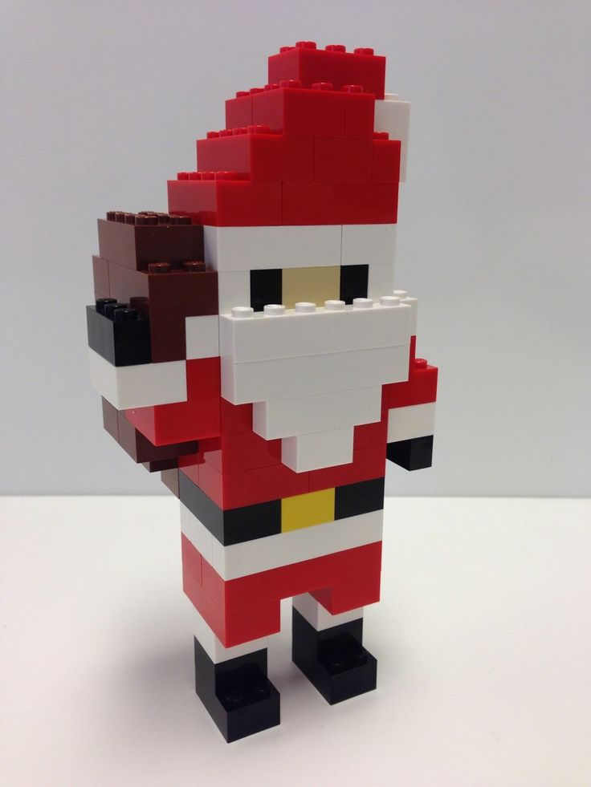
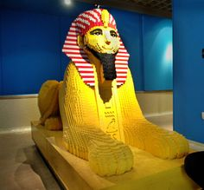
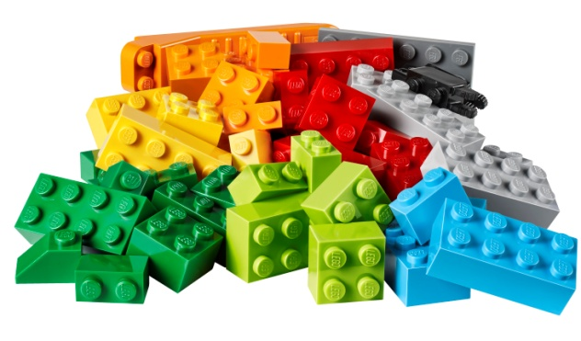
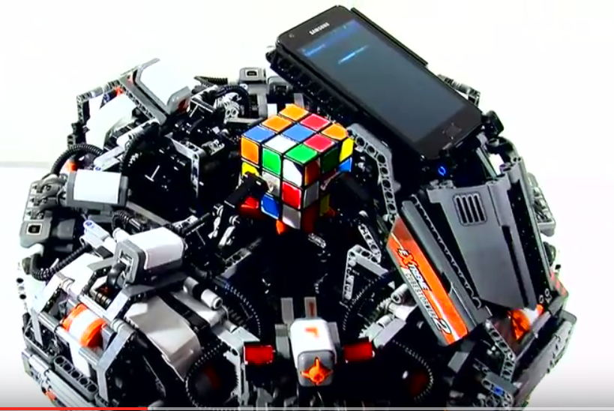
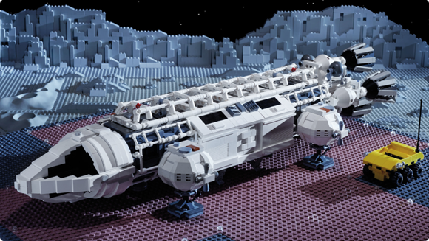
Why
https://photos.google.com/search/ water, goat, sunflower, chocolate cake, cup

Slide 3
What
“Field of study that gives computers the ability to learn without being explicitly programmed” Arthur Samuel - 1959

Slide 4
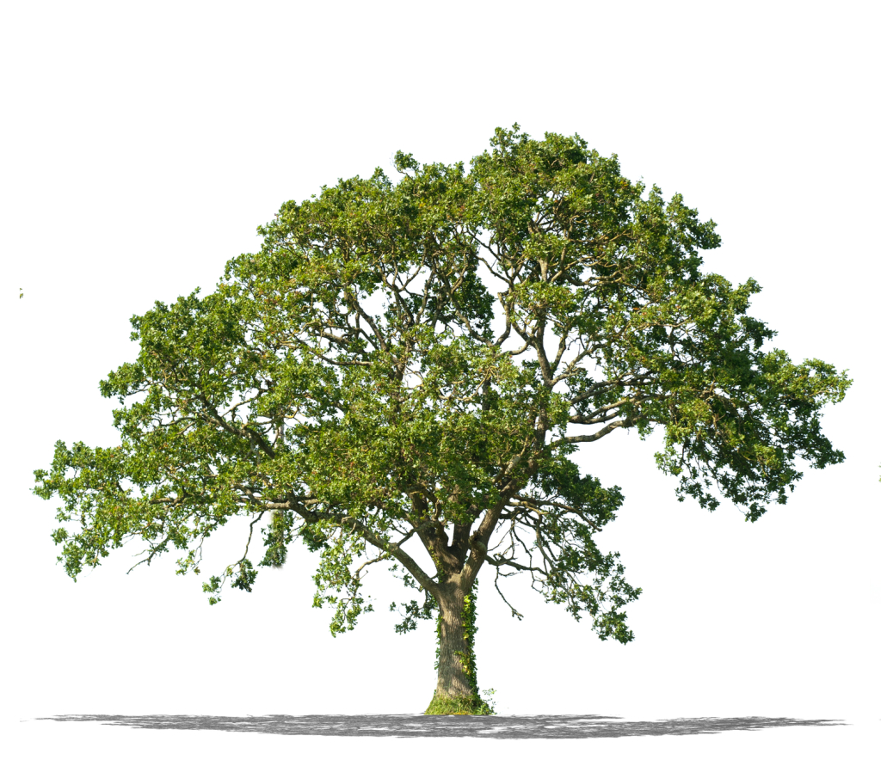
How?

Slide 5
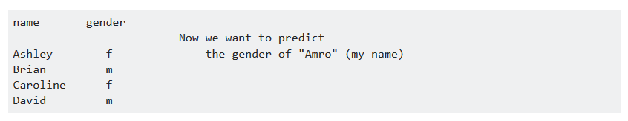
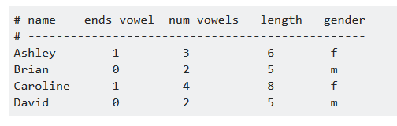
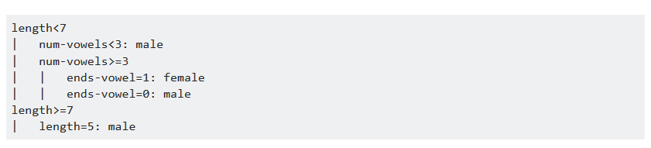
How it works
http://stackoverflow.com/a/1859910

Slide 6
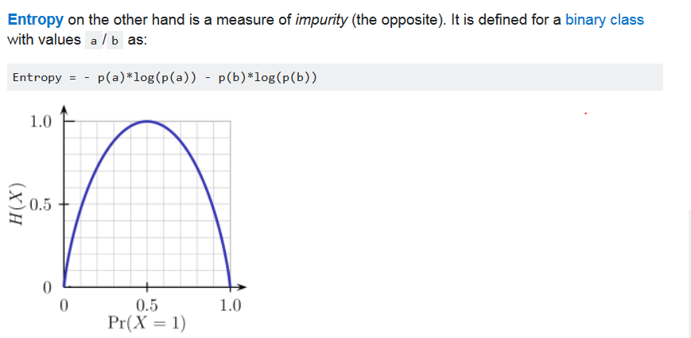
Entropy
http://stackoverflow.com/a/1859910

Slide 7
Best information gain.

Slide 8
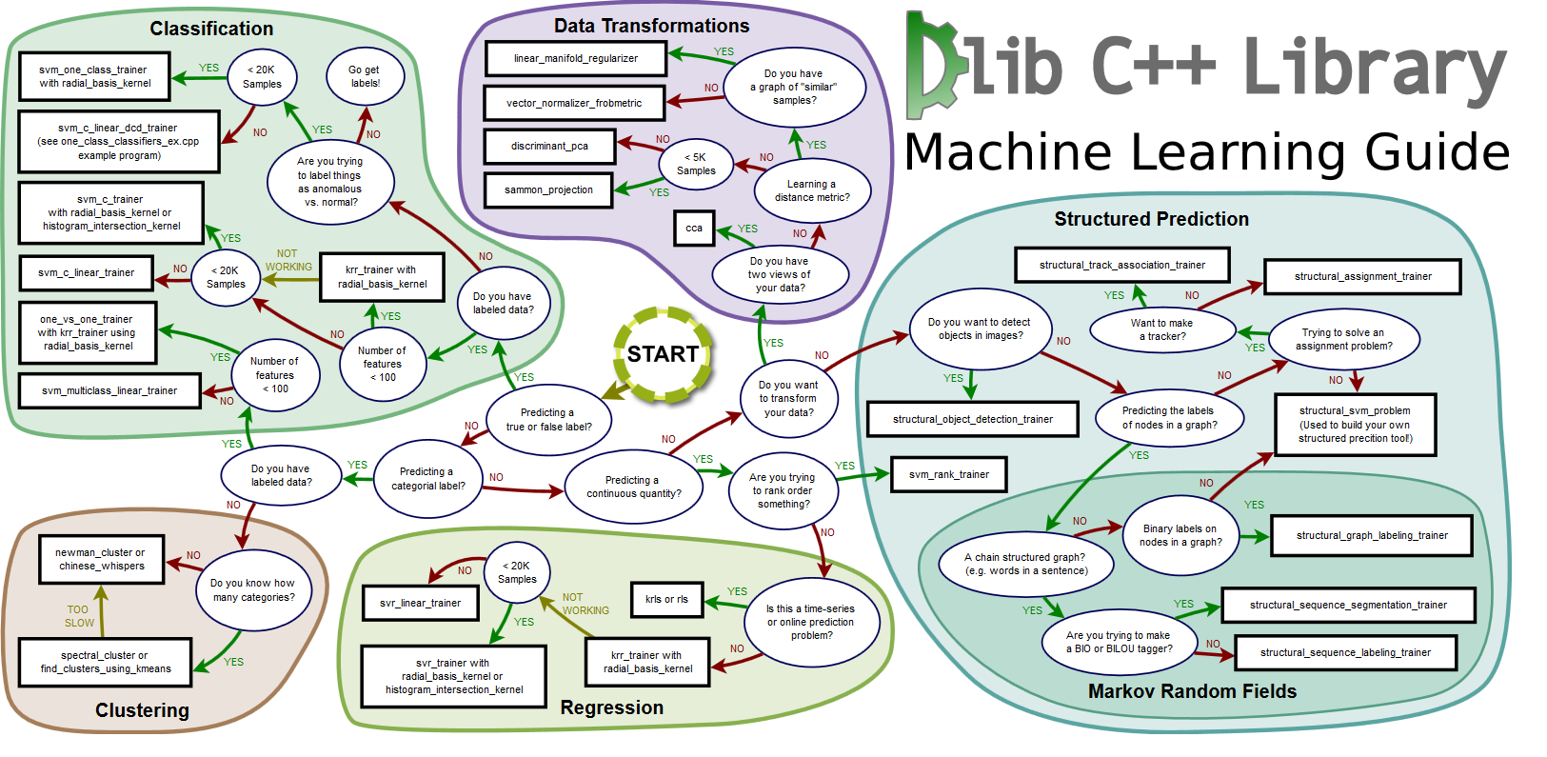
There are loads more techniques...

